Slide 1
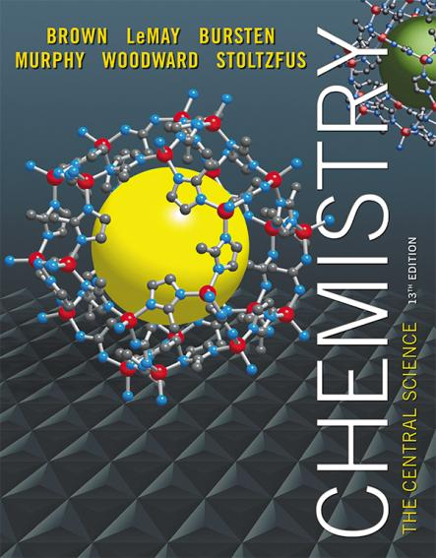
Lecture Presentation
Chapter 21 Nuclear Chemistry

Slide 2
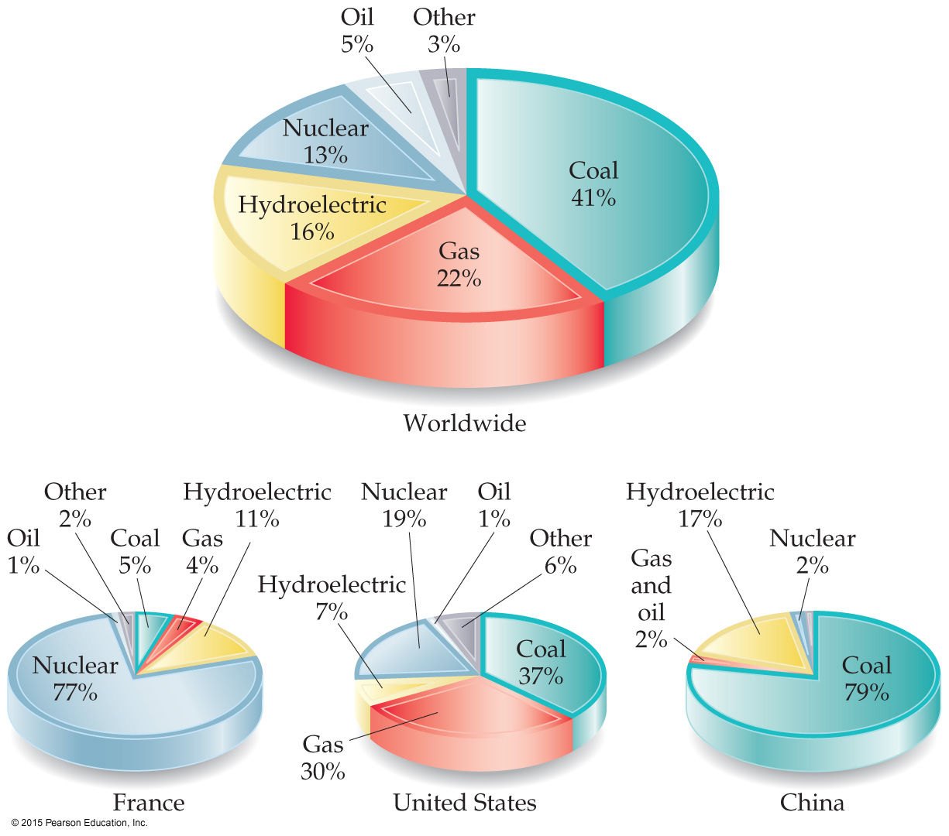
Energy: Chemical vs. Nuclear
Chemical energy is associated with making and breaking chemical bonds.
Nuclear energy is enormous in comparison.
Nuclear energy is due to changes in the nucleus of atoms changing them into different atoms.
13% of worldwide energy use comes from nuclear energy.

Slide 3
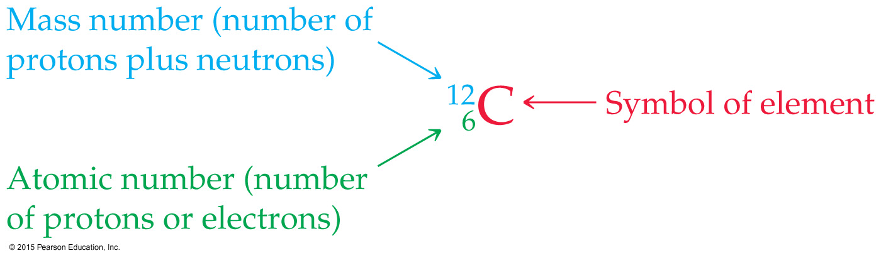
The Nucleus
Remember that the nucleus is composed of the two nucleons, protons and neutrons.
The number of protons is the atomic number.
The number of protons and neutrons together is the mass number.

Slide 4
Isotopes
Not all atoms of the same element have the same mass, due to different numbers of neutrons in those atoms.
There are, for example, three naturally occurring isotopes of uranium:
Uranium-234
Uranium-235
Uranium-238

Slide 5
Radioactivity
It is not uncommon for some nuclides of an element to be unstable, or radioactive.
We refer to these as radionuclides.
There are several ways radionuclides can decay into a different nuclide.
We use nuclear equations to show how these nuclear reactions occur.

Slide 6
Equations
In chemical equations, atoms and charges need to balance.
In nuclear equations, atomic number and mass number need to balance. This is a way of balancing charge (atomic number) and mass (mass number) on an atomic scale.

Slide 7
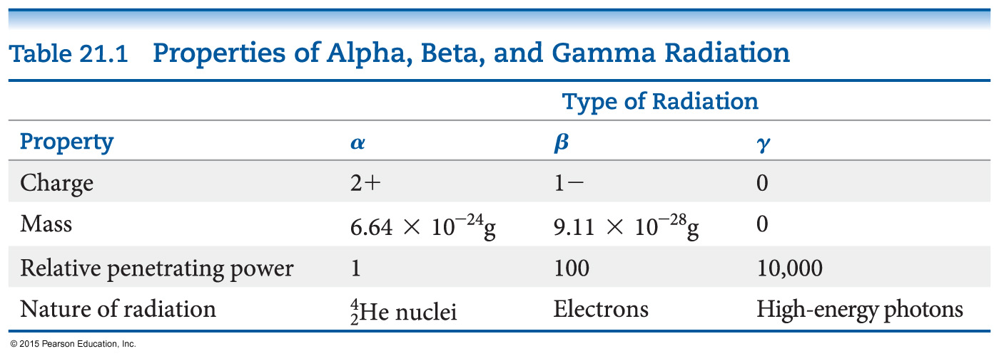
Most Common Kinds of Radiation Emitted by a Radionuclide

Slide 8
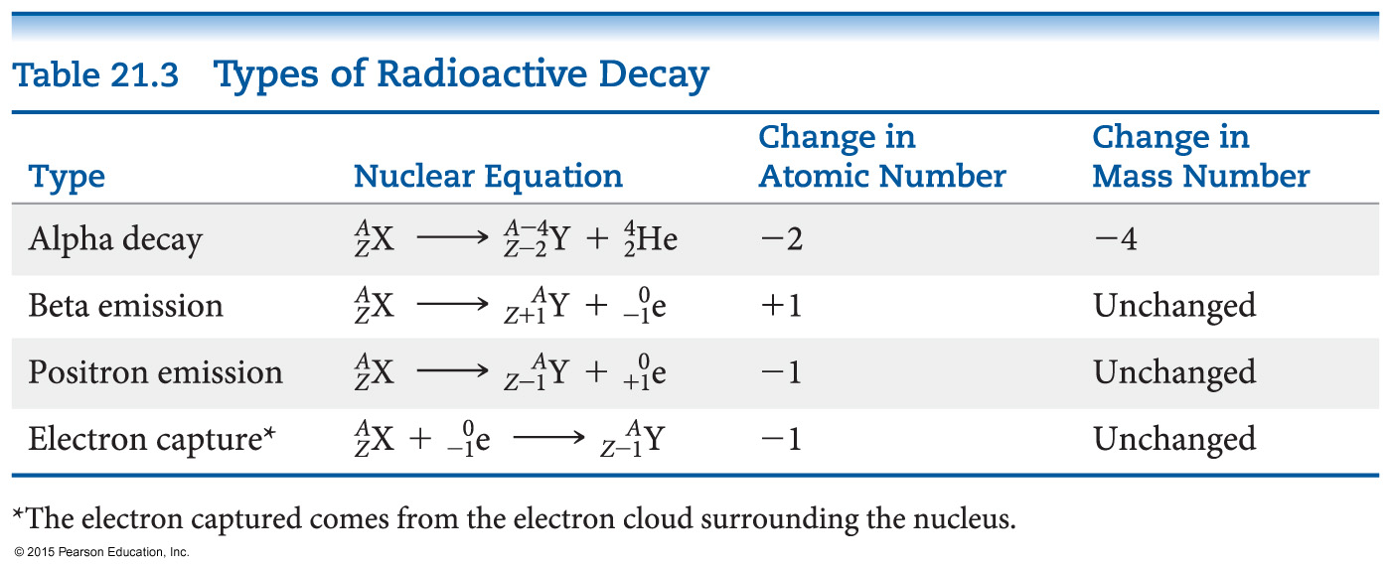
Types of Radioactive Decay
Alpha decay
Beta decay
Gamma emission
Positron emission
Electron capture

Slide 9
Alpha Decay
Alpha decay is the loss of an α-particle (He-4 nucleus, two protons and two neutrons):
4
2
He
238
92
U
234
90
4
2
Th
+
He
⎯⎯→
Note how the equation balances:
atomic number: 92 = 90 + 2
mass number: 238 = 234 + 4

Slide 10
Beta Decay
Beta decay is the loss of a β-particle (a high-speed electron emitted by the nucleus):
0
–1
β
0
–1
e
or
131
53
I
131
54
Xe
+
0
–1
e
⎯⎯→
Balancing: atomic number: 53 = 54 + (–1)
mass number: 131 = 131 + 0

Slide 11
Gamma Emission
Gamma emission is the loss of a γ-ray, which is high-energy radiation that almost always accompanies the loss of a nuclear particle:
γ
0
0

Slide 12
Positron Emission
Some nuclei decay by emitting a positron, a particle that has the same mass as, but an opposite charge to, that of an electron:
0
1
e
11
6
C
11
5
B
0
1
+
e
⎯⎯→
Balancing: atomic number: 6 = 5 + 1
mass number: 11 = 11 + 0

Slide 13
Electron Capture (K-Capture)
An electron from the surrounding electron cloud is absorbed into the nucleus during electron capture.
81
37
Rb
+
0
–1
e
81
36
Kr
⎯⎯→
Balancing: atomic number: 37 + (–1) = 36
mass number: 81 + 0 = 81

Slide 14
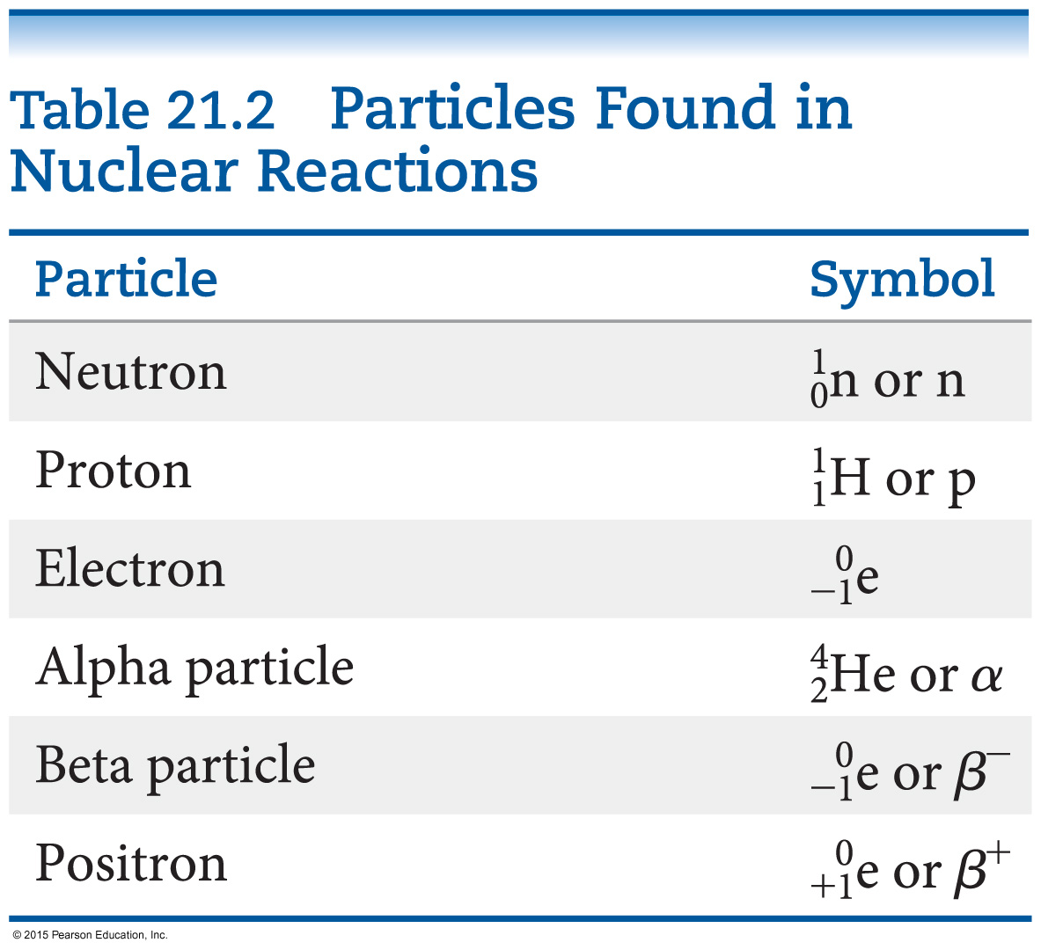
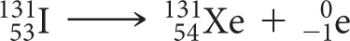

Sources of Some Nuclear Particles
Beta particles:
Positrons:
What happens with electron capture?

Slide 15
Nuclear Stability
Any atom with more than one proton (anything but H) will have repulsions between the protons in the nucleus.
Strong nuclear force helps keep the nucleus together.
Neutrons play a key role stabilizing the nucleus, so the ratio of neutrons to protons is an important factor.

Slide 16
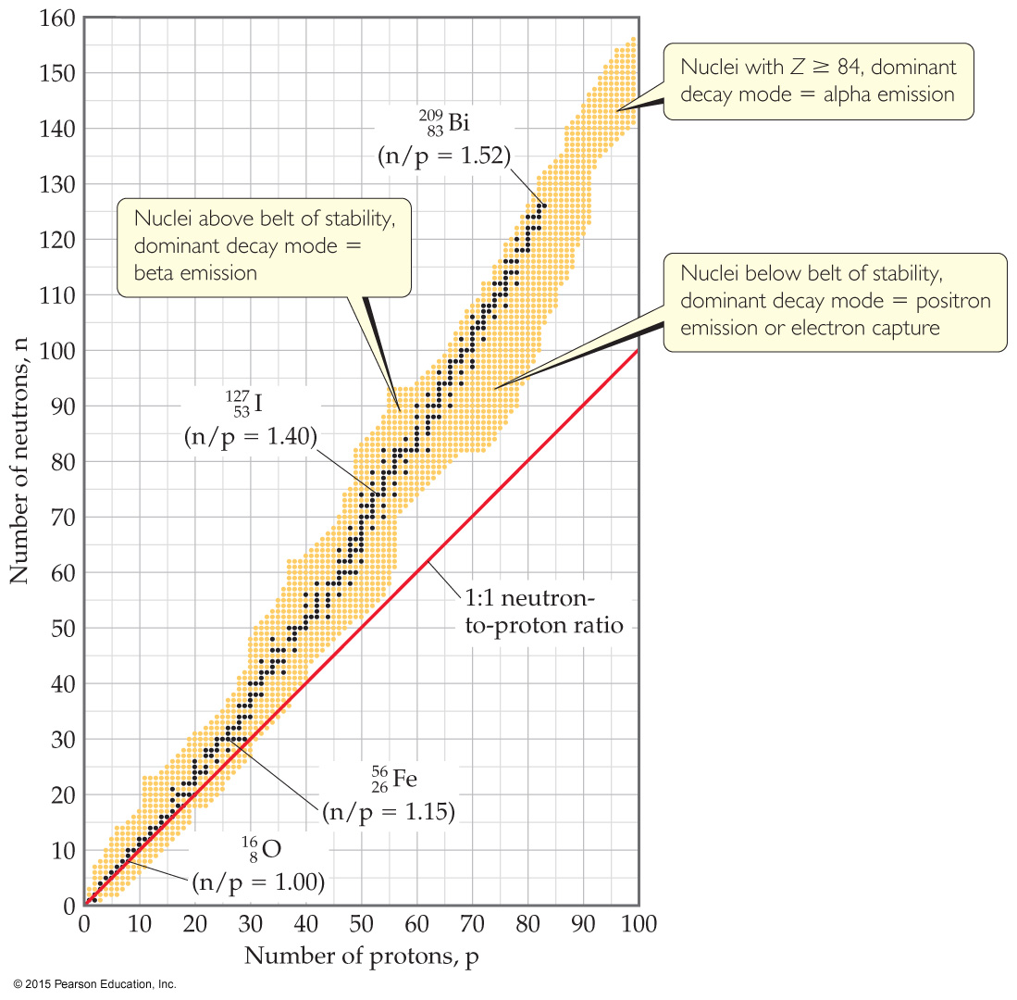
Neutron–Proton Ratios
For smaller nuclei (Z ≤ 20), stable nuclei have a neutron-to-proton ratio close to 1:1.
As nuclei get larger, it takes a larger number of neutrons to stabilize the nucleus.
The shaded region in the figure is called the belt of stability; it shows what nuclides would be stable.

Slide 17
Unstable Nuclei
Compare a nucleus to the “belt of stability.”
Nuclei above this belt have too many neutrons, so they tend to decay by emitting beta particles.
Nuclei below the belt have too many protons, so they tend to become more stable by positron emission or electron capture.

Slide 18
Alpha Emission
There are no stable nuclei with an atomic number greater than 83.
Nuclei with such large atomic numbers tend to decay by alpha emission.

Slide 19
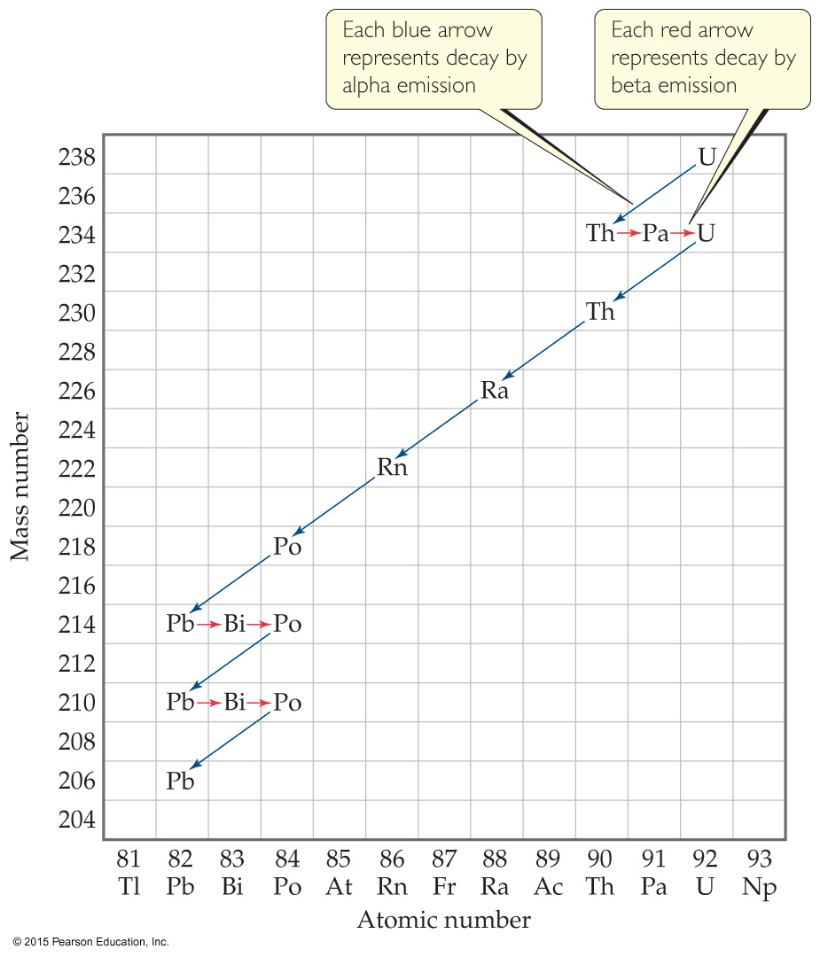
Radioactive Decay Chain
Some radioactive nuclei cannot stabilize by undergoing only one nuclear transformation.
They undergo a series of decays until they form a stable nuclide (often a nuclide of lead).

Slide 20
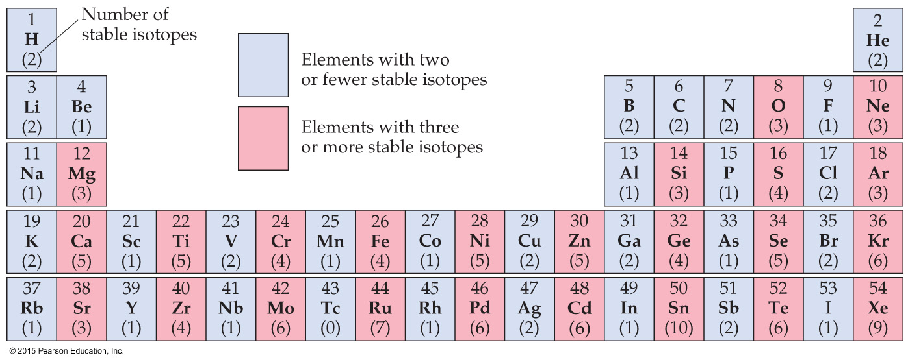
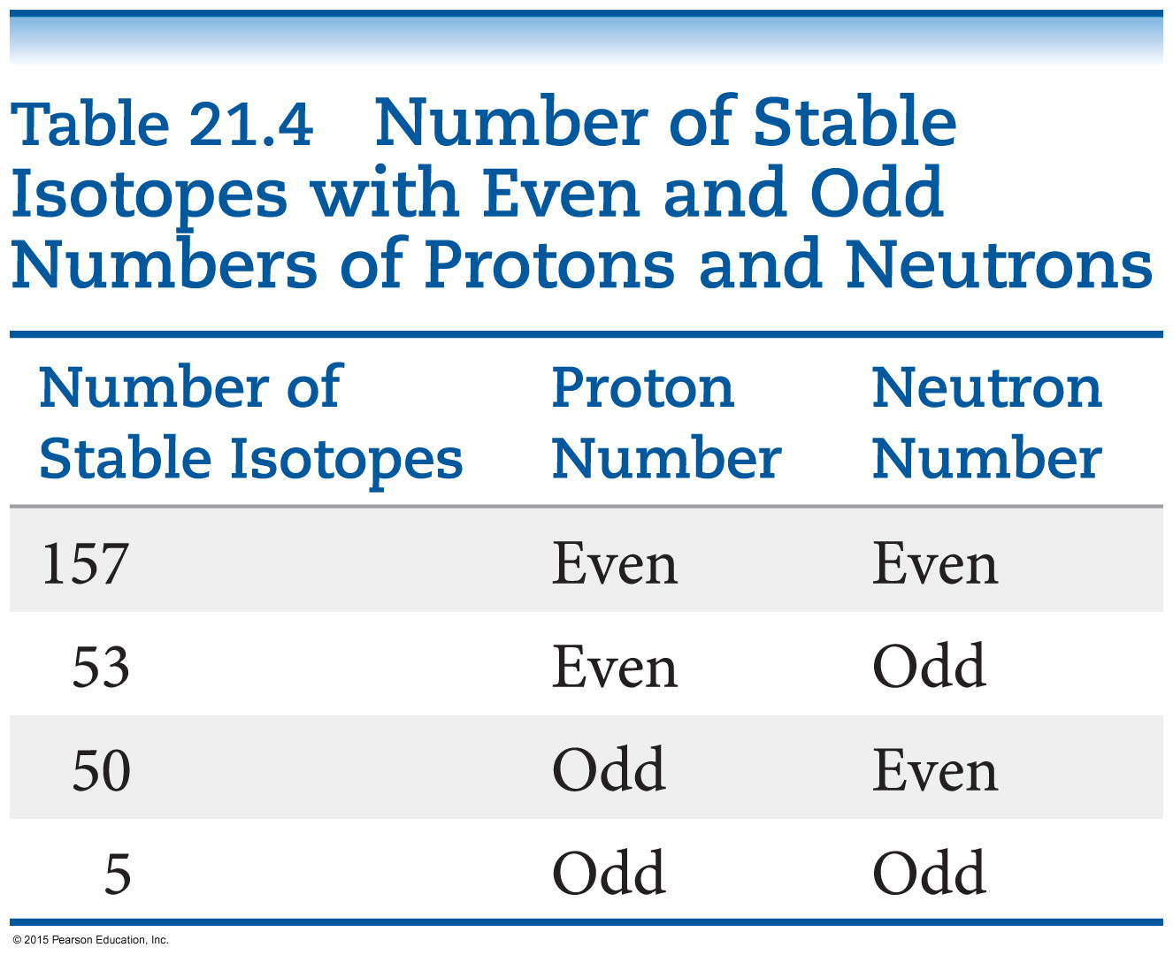
Stable Nuclei
Magic numbers of 2, 8, 20, 28, 50, or 82 protons or 2, 8, 20, 28, 50, 82, or 126 neutrons result in more stable nuclides.
Nuclei with an even number of protons and neutrons tend to be more stable than those with odd numbers.

Slide 21
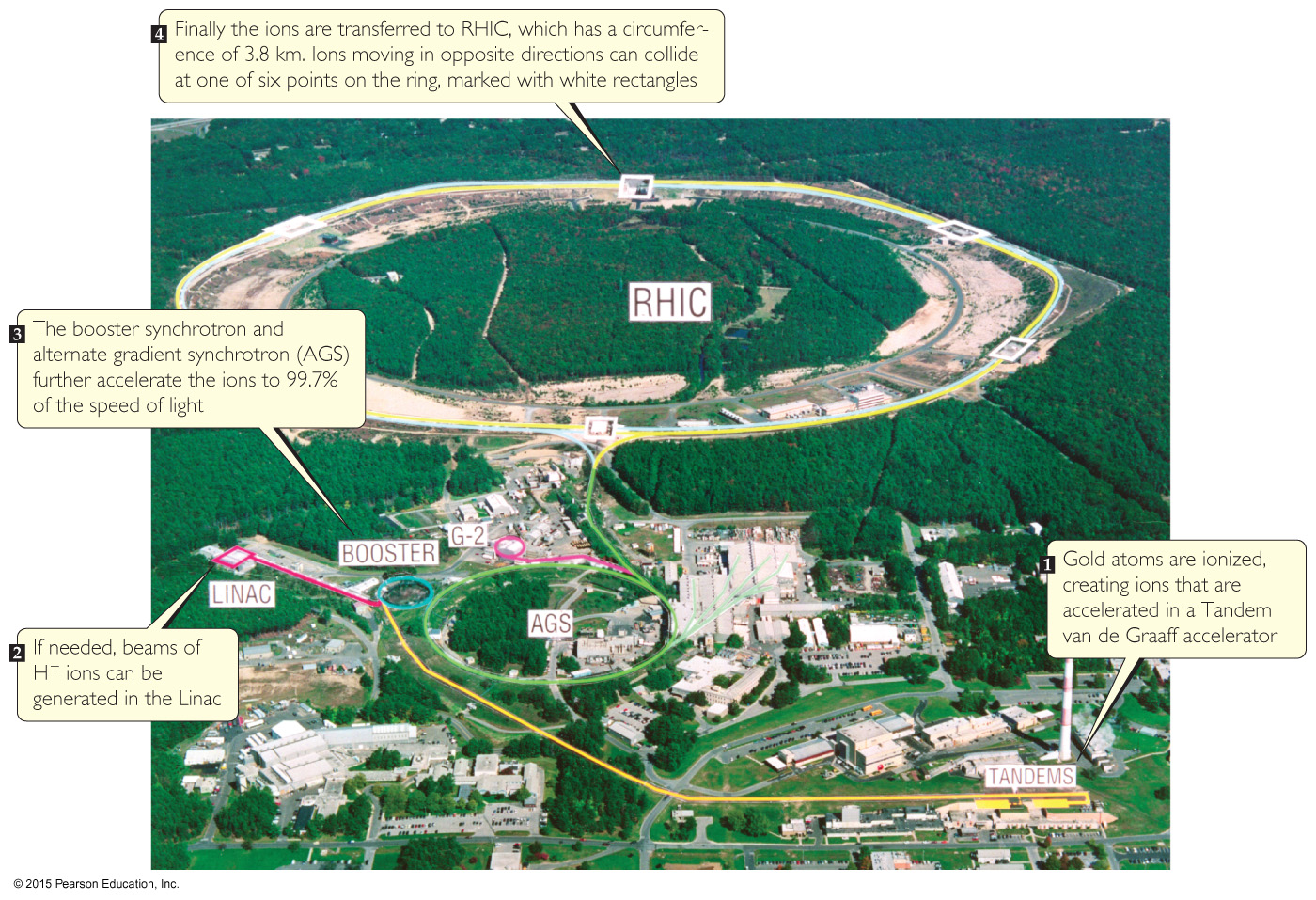
Nuclear Transmutations
Nuclear transmutations can be induced by accelerating a particle to collide it with the nuclide.
Particle accelerators (“atom smashers”) are enormous, having circular tracks with radii that are miles long.

Slide 22
Other Nuclear Transmutations
Use of neutrons:
Most synthetic isotopes used in medicine are prepared by bombarding neutrons at a particle, which won’t repel the neutral particle.
Transuranium elements:
Elements immediately after uranium were discovered by bombarding isotopes with neutrons.
Larger elements (atomic number higher than 110) were made by colliding large atoms with nuclei of light elements with high energy.

Slide 23
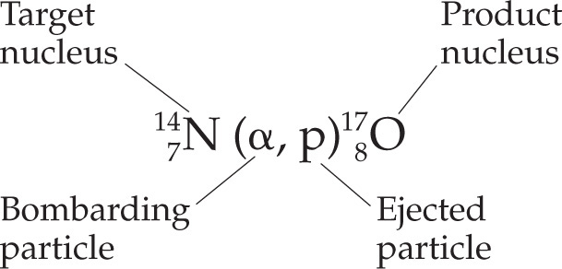
Writing Nuclear Equations for Nuclear Transmutations
Nuclear equations that represent nuclear transmutations are written two ways:
or

Slide 24
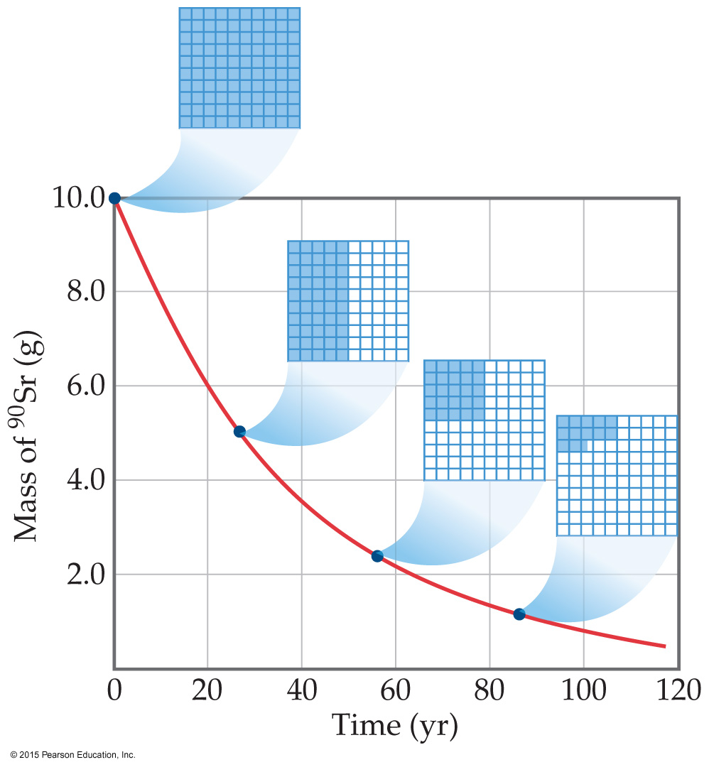
Kinetics of Radioactive Decay
Radioactive decay is a first-order process.
The kinetics of such a process obey this equation:
N_{t}
N₀
ln
= −kt

Slide 25
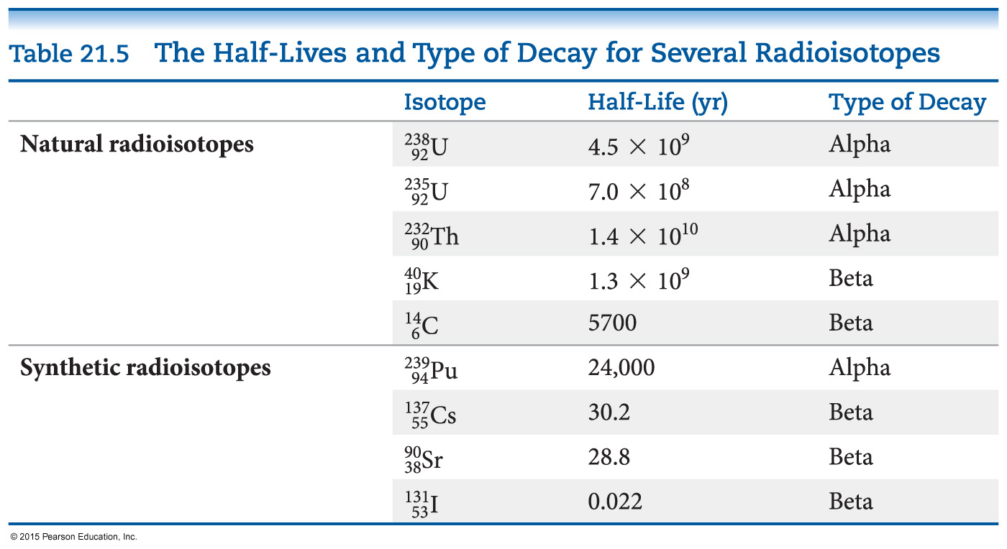
Half-Life
The half-life of such a process is
0.693
k
= t_{1/2}
Half-life is the time required for half of a radionuclide sample to decay.

Slide 26
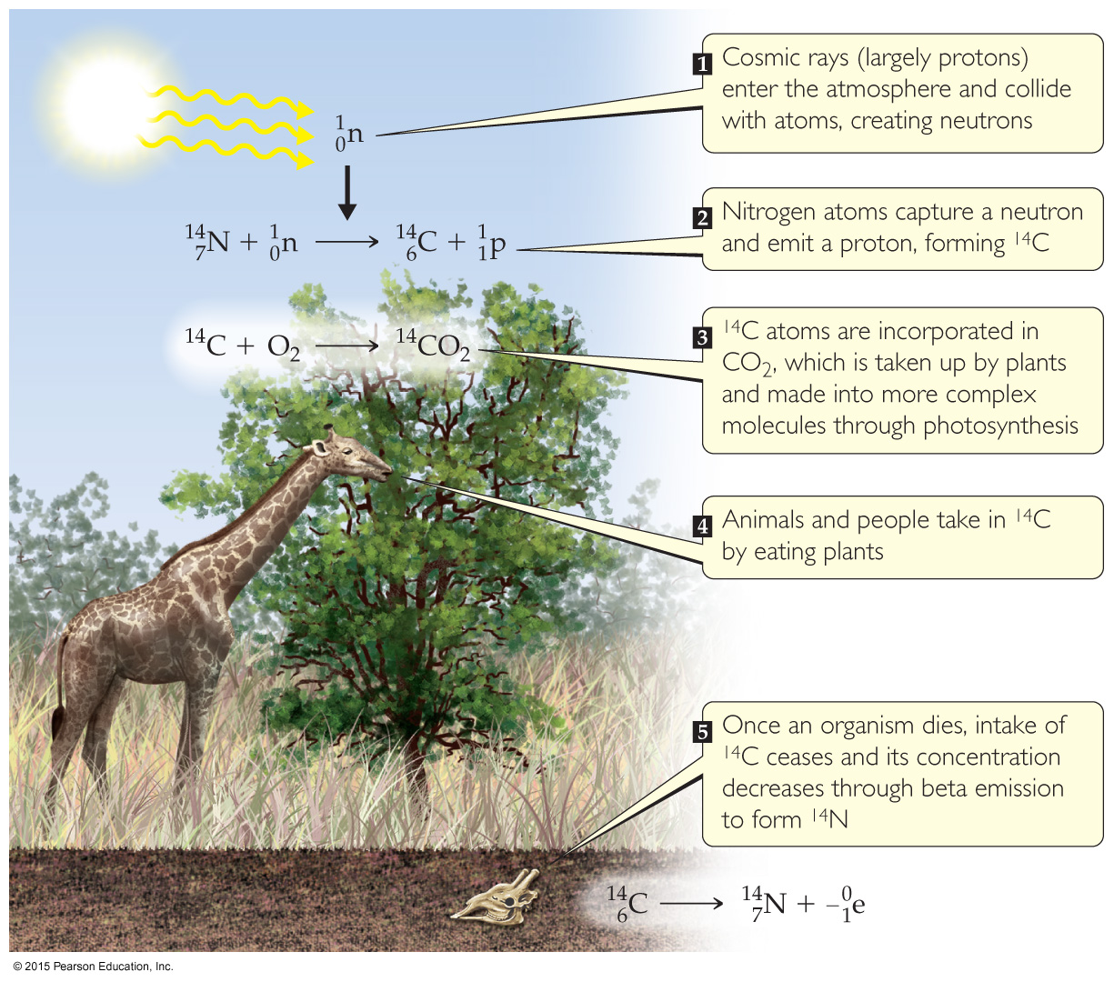
Radiometric Dating
Applying first-order kinetics and half-life information, we can date objects using a “nuclear clock.”
Carbon dating works: the half-life of C-14 is 5700 yr. It is limited to objects up to about 50,000 yr old; after this time there is too little radioactivity left to measure.
Other isotopes can be used (U-238:Pb-206 in rock).

Slide 27
Measuring Radioactivity: Units
Activity is the rate at which a sample decays.
The units used to measure activity are as follows:
Becquerel (Bq): one disintegration per second
Curie (Ci): 3.7 × 10¹⁰ disintegrations per second, which is the rate of decay of 1 g of radium.

Slide 28
Measuring Radioactivity: Some Instruments
Film badges
Geiger counter
Phosphors (scintillation counters)

Slide 29
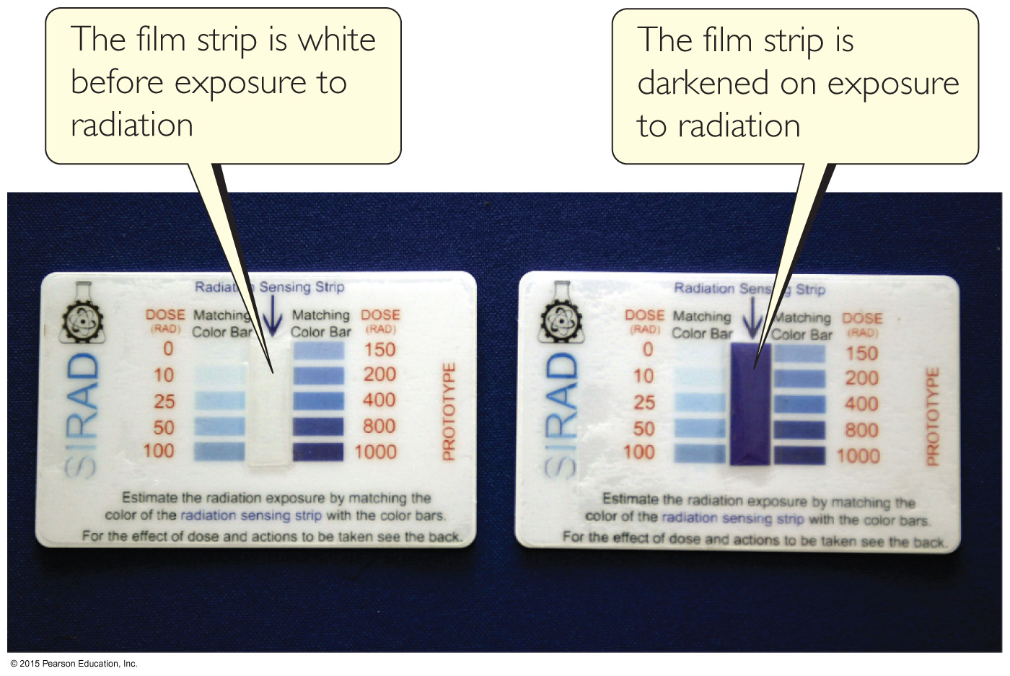
Film Badges
Radioactivity was first discovered by Henri Becquerel because it fogged up a photographic plate.
Film has been used to detect radioactivity since more exposure to radioactivity means darker spots on the developed film.
Film badges are used by people who work with radioactivity to measure their own exposure over time.

Slide 30
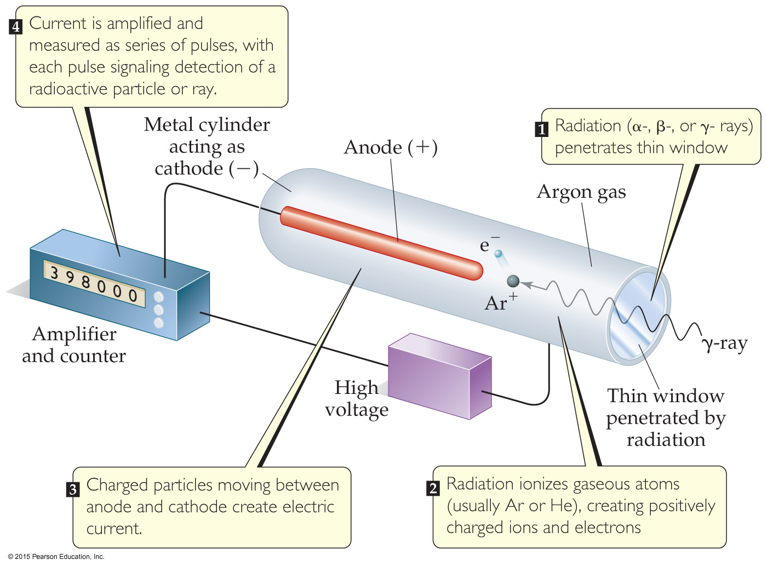
Geiger Counter
A Geiger counter measures the amount of activity present in a radioactive sample.
Radioactivity enters a window and creates ions in a gas; the ions result in an electric current that is measured and recorded by the instrument.

Slide 31
Phosphors
Some substances absorb radioactivity and emit light. They are called phosphors.
An instrument commonly used to measure the amount of light emitted by a phosphor is a scintillation counter. It converts the light to an electronic response for measurement.

Slide 32
Radiotracers
Radiotracers are radioisotopes used to study a chemical reaction.
An element can be followed through a reaction to determine its path and better understand the mechanism of a chemical reaction.

Slide 33
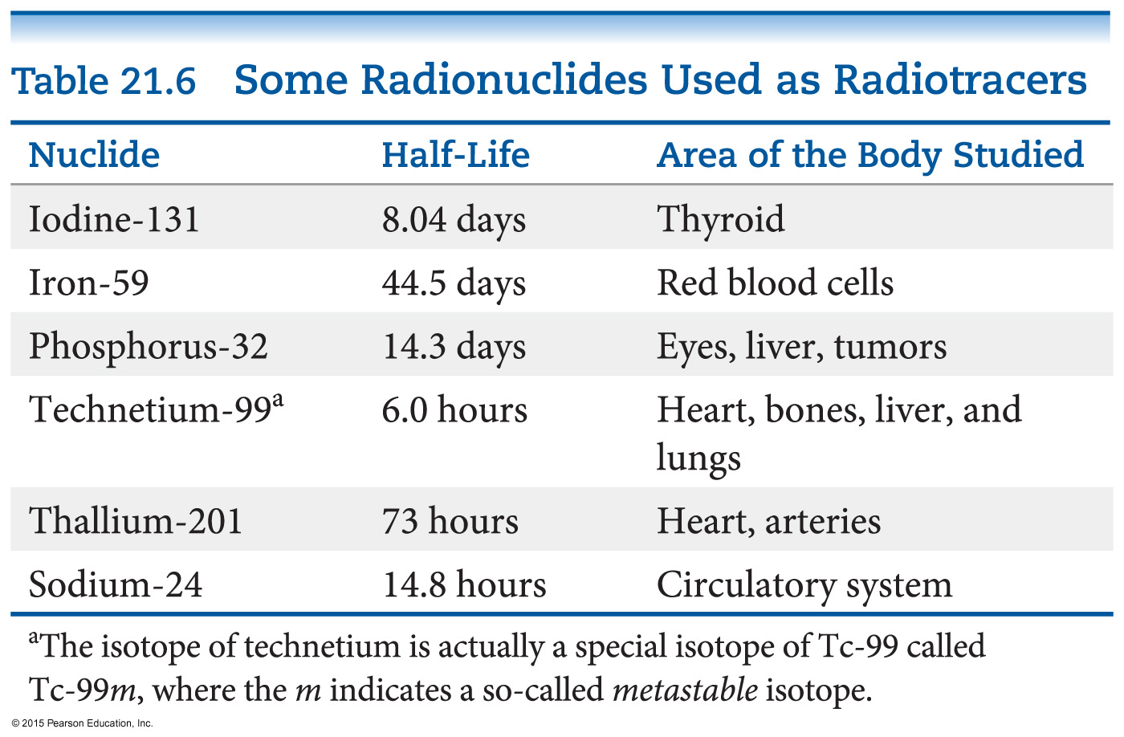
Medical Application of Radiotracers
Radiotracers have found wide diagnostic use in medicine.
Radioisotopes are administered to a patient (usually intravenously) and followed. Certain elements collect more in certain tissues, so an organ or tissue type can be studied based on where the radioactivity collects.

Slide 34
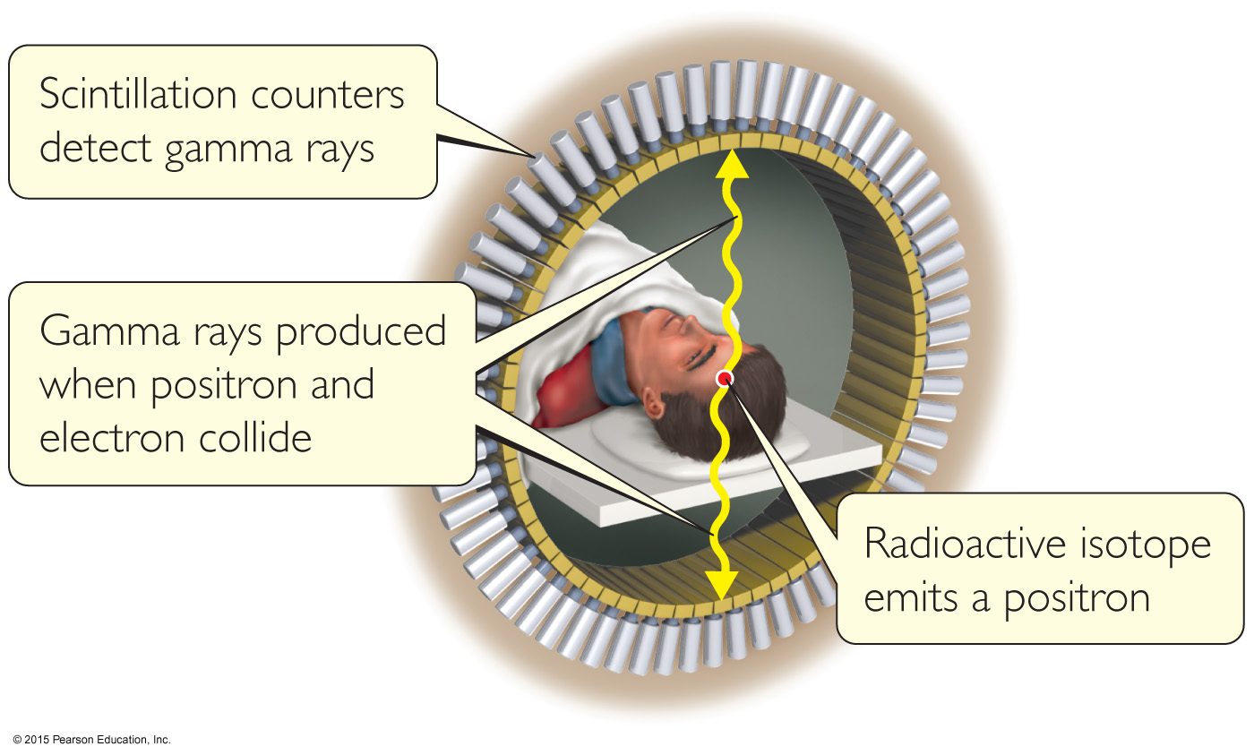
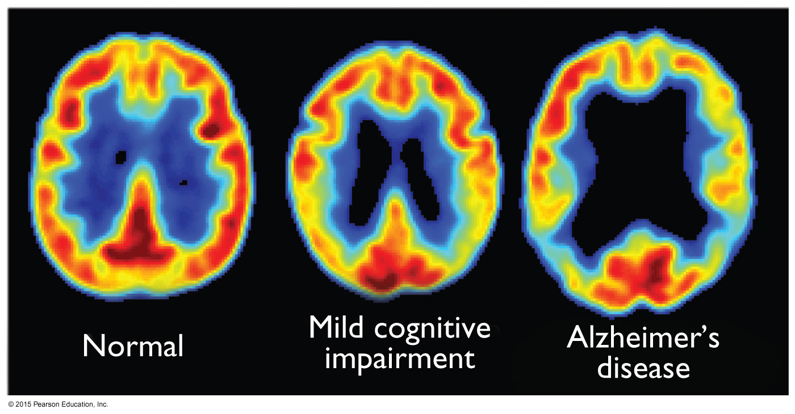
Positron Emission Tomography (PET Scan)
A compound labeled with a positron emitter is injected into a patient.
Blood flow, oxygen and glucose metabolism, and other biological functions can be studied.
Labeled glucose is used to study the brain, as seen in the figure to the right.

Slide 35
Energy in Nuclear Reactions
There is a tremendous amount of energy stored in nuclei.
Einstein’s famous equation, E = mc², relates directly to the calculation of this energy.

Slide 36
Energy in Nuclear Reactions
To show the enormous difference in energy for nuclear reactions, the mass change associated with the α-decay of 1 mol of U-238 to Th-234 is –0.0046 g.
The change in energy, ΔE, is then
ΔE = (Δm)c²
ΔE = (–4.6 × 10^{–6} kg)(3.00 × 10⁸ m/s)²
ΔE = –4.1 × 10¹¹ J
(Note: the negative sign means heat is released.)

Slide 37
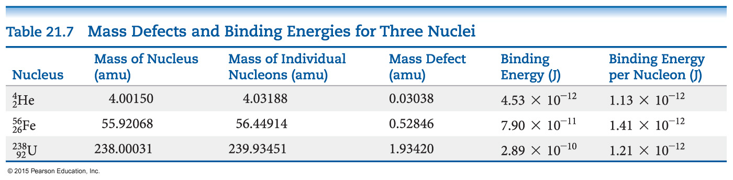
Mass Defect
Where does this energy come from?
The masses of nuclei are always less than those of the individual parts.
This mass difference is called the mass defect.
The energy needed to separate a nucleus into its nucleons is called the nuclear binding energy.

Slide 38
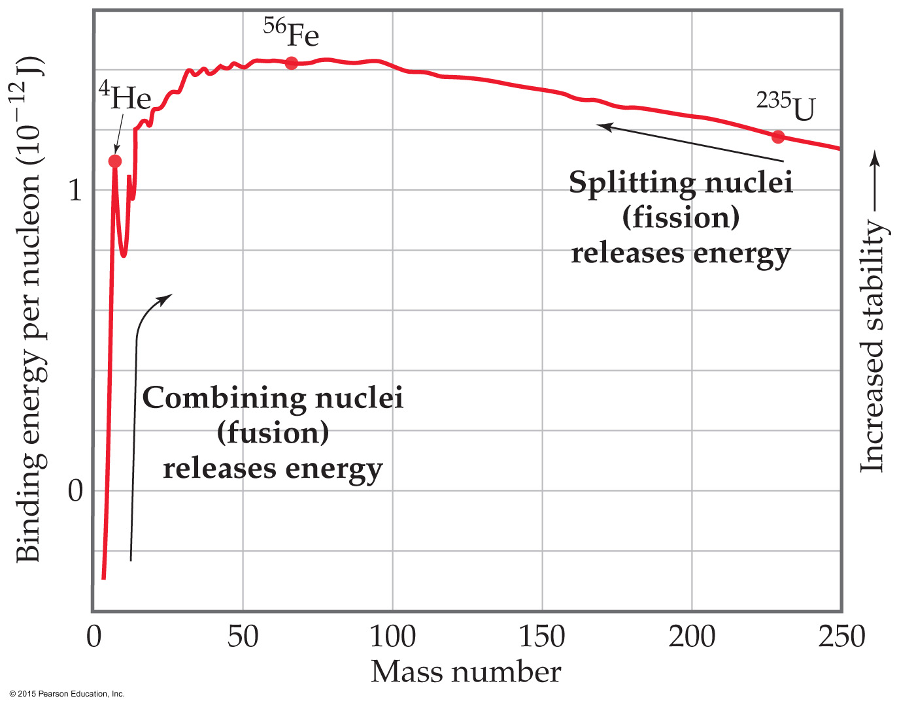
Effects of Nuclear Binding Energy on Nuclear Processes
Dividing the binding energy by the number of nucleons gives a value that can be compared.
Heavy nuclei gain stability and give off energy when they split into two smaller nuclei. This is fission.
Lighter nuclei emit great amounts of energy by being combined in fusion.

Slide 39
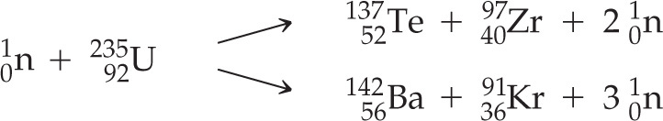
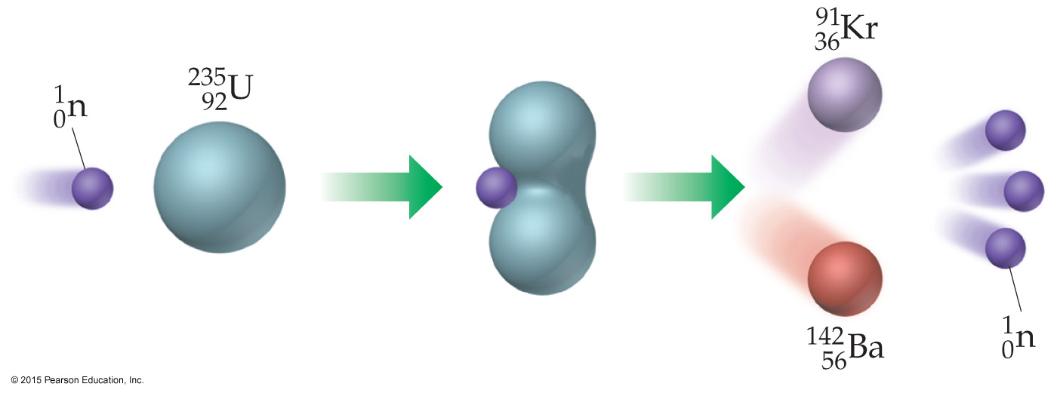
Nuclear Fission
Commercial nuclear power plants use fission.
Heavy nuclei can split in many ways. The equations below show two ways U-235 can split after bombardment with a neutron.

Slide 40
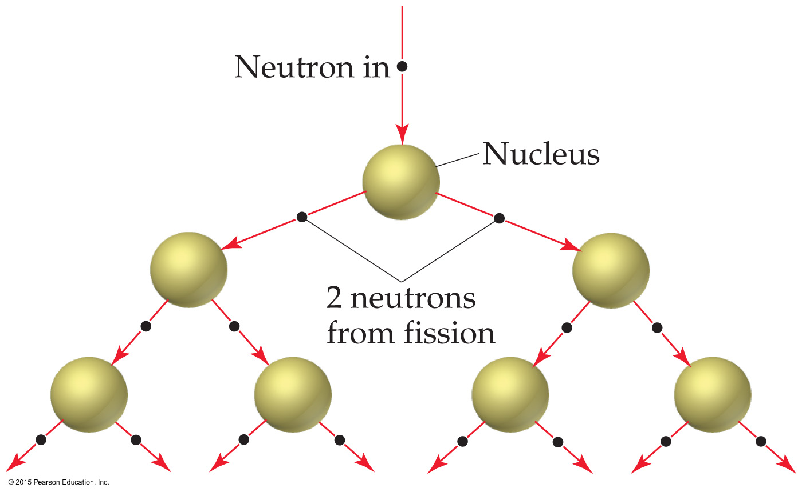
Nuclear Fission
Bombardment of the radioactive nuclide with a neutron starts the process.
Neutrons released in the transmutation strike other nuclei, causing their decay and the production of more neutrons.
This process continues in what we call a nuclear chain reaction.

Slide 41
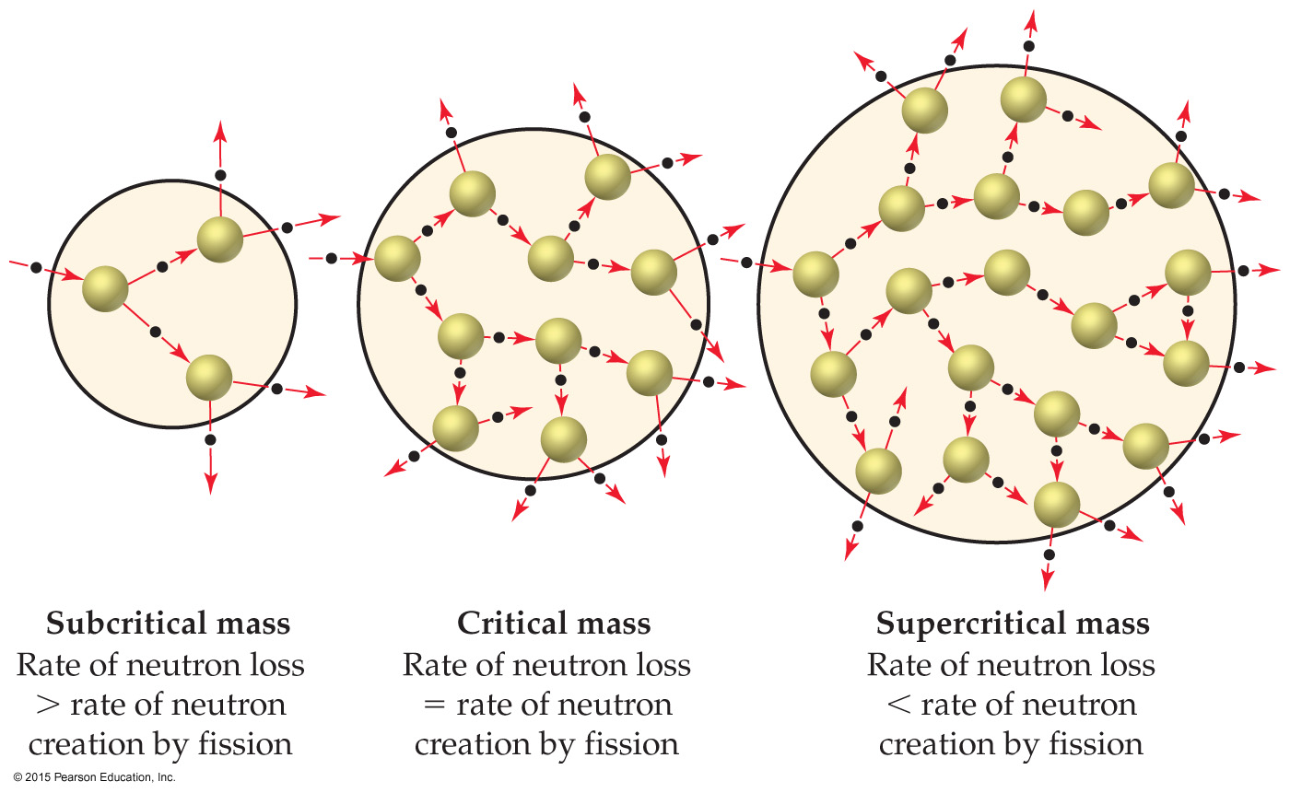
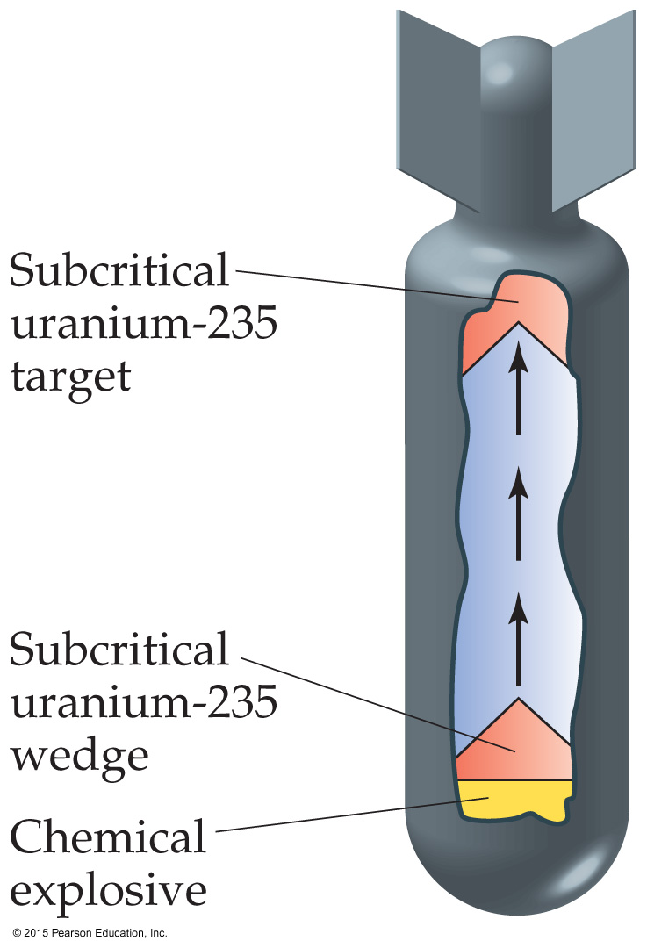
Nuclear Fission
The minimum mass that must be present for a chain reaction to be sustained is called the critical mass.
If more than critical mass is present (supercritical mass), an explosion will occur. Weapons were created by causing smaller amounts to be forced together to create this mass.

Slide 42
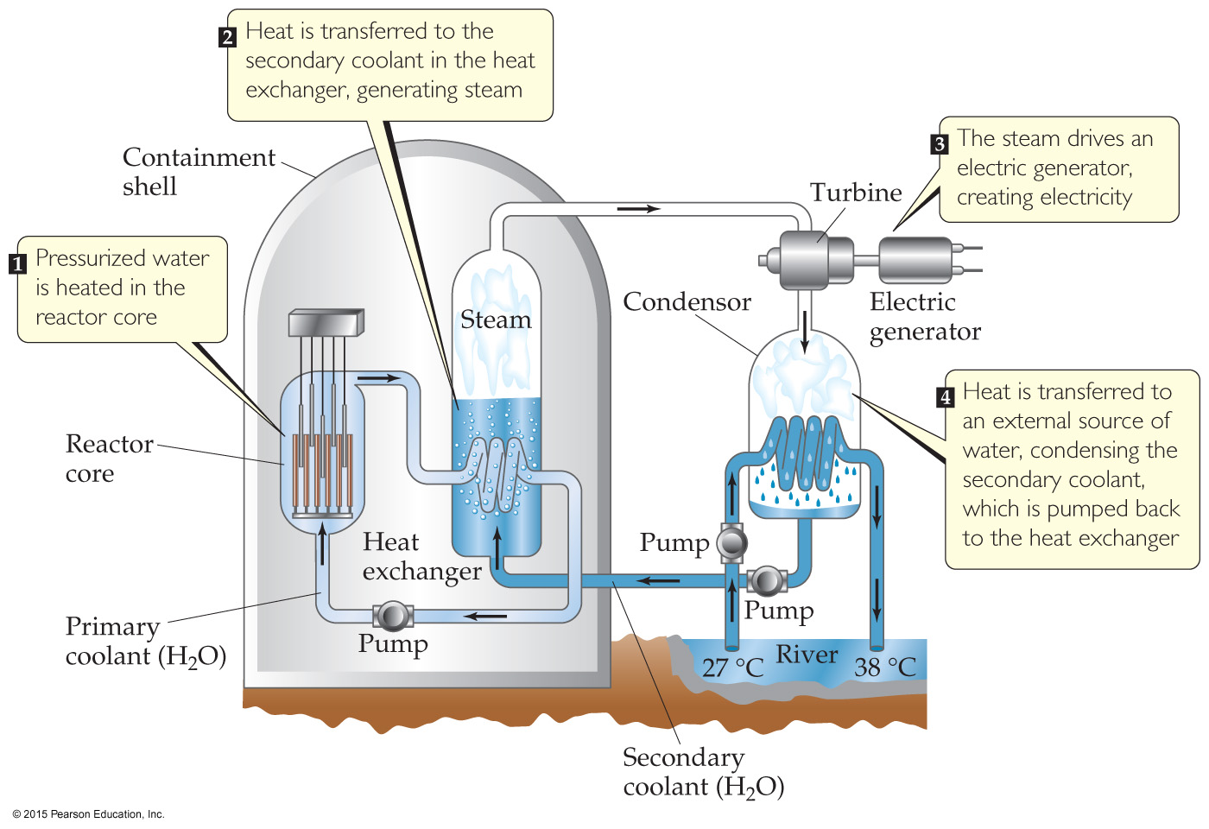
Nuclear Reactors
In nuclear reactors, the heat generated by the reaction is used to produce steam that turns a turbine connected to a generator. Otherwise, the plant is basically the same as any power plant.

Slide 43
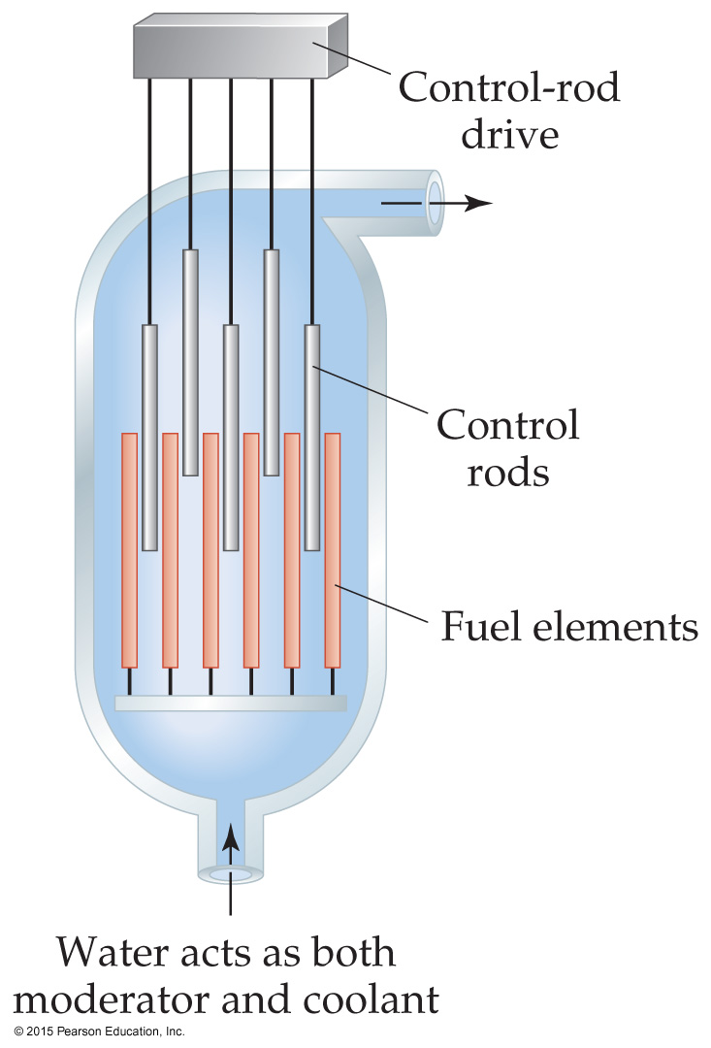
Nuclear Reactors
The reactor core consists of fuel rods, control rods, moderators, and coolant.
The control rods block the paths of some neutrons, keeping the system from reaching a dangerous supercritical mass.

Slide 44
Nuclear Waste
Reactors must be stopped periodically to replace or reprocess the nuclear fuel.
They are stored in pools at the reactor site.
The original intent was that this waste would then be transported to reprocessing or storage sites.
Political opposition to storage site location and safety challenges for reprocessing have led this to be a major social problem.

Slide 45
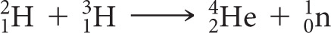
Nuclear Fusion
When small atoms are combined, much energy is released.
If it were possible to easily produce energy by this method, it would be a preferred source of energy.
However, extremely high temperatures and pressures are needed to cause nuclei to fuse.
This was achieved using an atomic bomb to initiate fusion in a hydrogen bomb. Obviously, this is not an acceptable approach to producing energy.

Slide 46
Radiation in the Environment
We are constantly exposed to radiation.
Ionizing radiation is more harmful to living systems than nonionizing radiation, such as radiofrequency electromagnetic radiation.
Since most living tissue is ~70% water, ionizing radiation is that which causes water to ionize.
This creates unstable, very reactive OH radicals, which result in much cell damage.

Slide 47
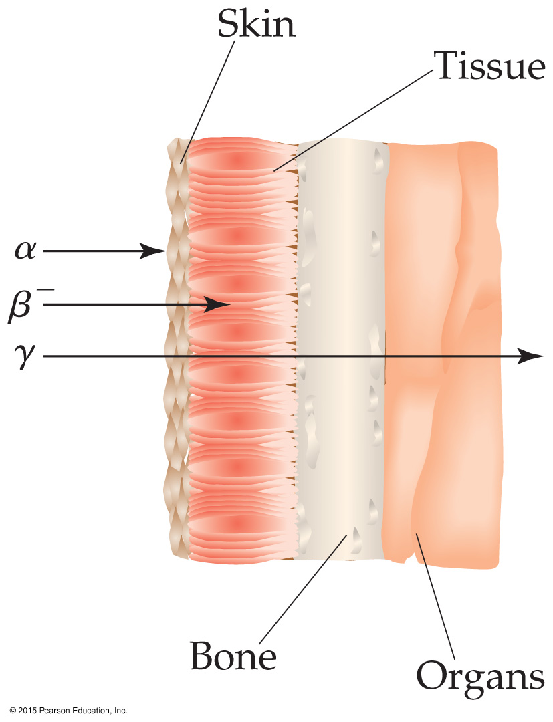
Damage to Cells
The damage to cells depends on the type of radioactivity, the length of exposure, and whether the source is inside or outside the body.
Outside the body, gamma rays are most dangerous.
Inside the body, alpha radiation can cause most harm.

Slide 48
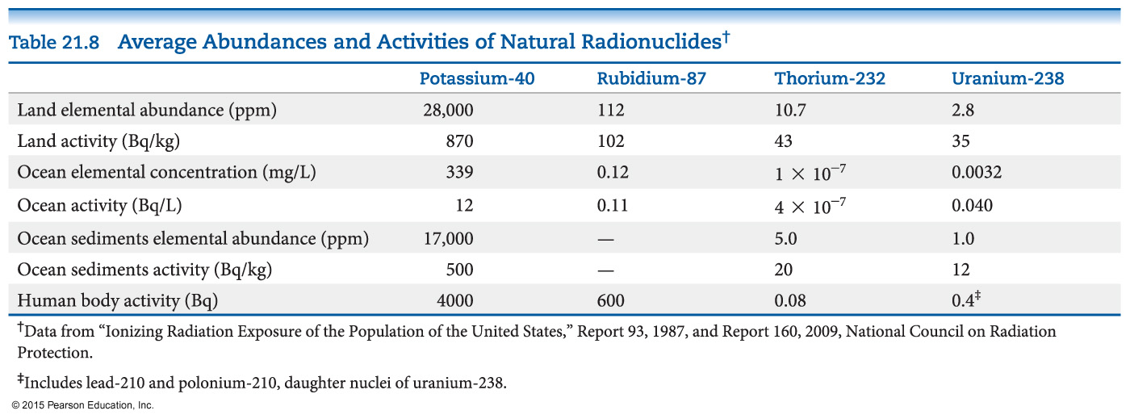
Exposure
We are constantly exposed to radiation. What amount is safe?
Setting standards for safety is difficult.
Low-level, long-term exposure can cause health issues.
Damage to the growth-regulation mechanism of cells results in cancer.

Slide 49
Radiation Dose
Two units are commonly used to measure exposure to radiation:
Gray (Gy): absorption of 1 J of energy per kg of tissue
Rad (for radiation absorbed dose): absorption of 0.01 J of energy per kg of tissue (100 rad = 1 Gy)
Not all forms of radiation harm tissue equally. A relative biological effectiveness (RBE) is used to show how much biological effect there is.
The effective dose is called the rem (SI unit Sievert; 1 Sv = 100 rem)
# of rem = (# of rad) (RBE)

Slide 50
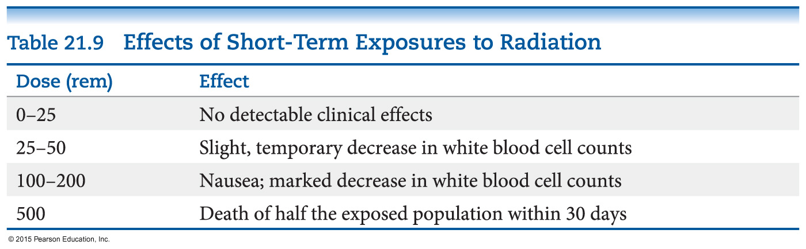
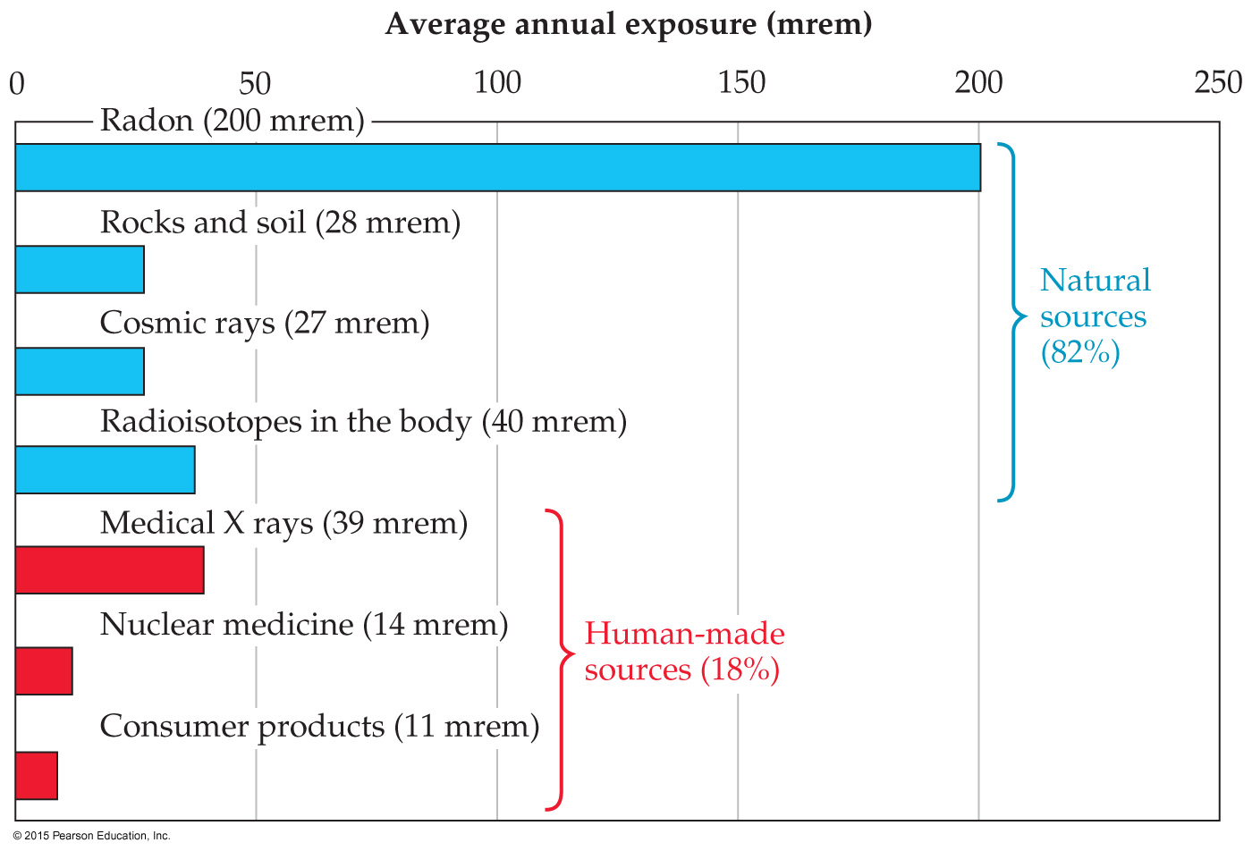
Short-Term Exposure
600 rem is fatal to most humans.
Average exposure per year is about 360 mrem.

Slide 51
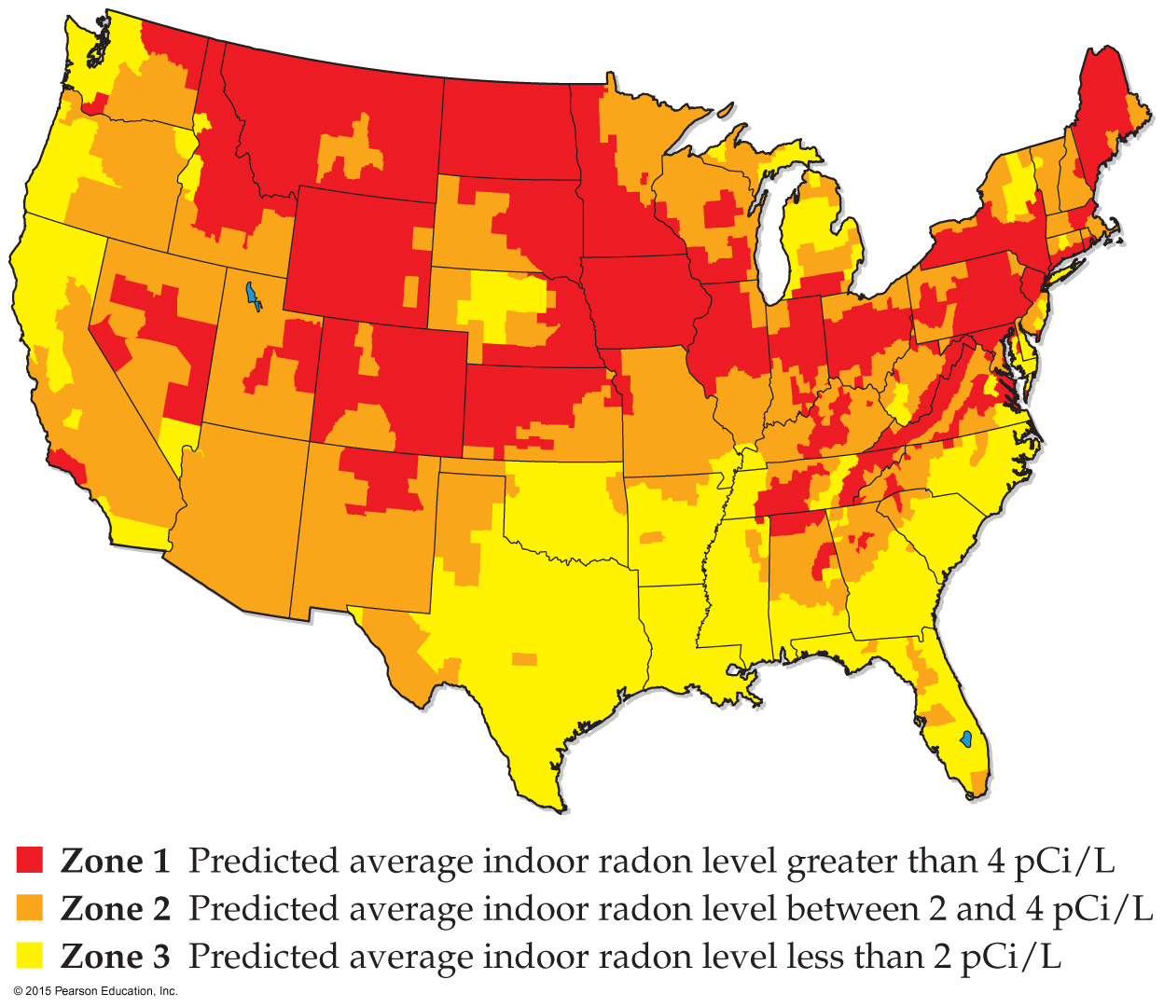
Radon
Radon-222 is a decay product of uranium-238, which is found in rock formations and soil.
Most of the decay products of uranium remain in the soil, but radon is a gas.
When breathed in, it can cause much harm, since it produces alpha particles, which have a high RBE.
It is estimated to contribute to 10% of all lung cancer deaths in the United States.

